Slide 1
“Barbecue and Sweet Tea”: The Changing Role of Law Enforcement in the Opioid Crisis and Building Partnerships with Public Health
Investigator Donnie Varnell
Dare County Sheriff’s Office
Donnie.varnell@darenc.com 336-338-1507

Slide 2
Lancaster County Coalition For Healthy Youth Prevention of Youth Substance Misuse September 6th, 2023
Investigator Donnie Varnell
Dare County Sheriff’s Office
336-338-1507 donnie.varnell@darenc.com

Slide 3
Law Enforcement and Harm Reduction
Objectives:
Identify 2 programs to reduce ODs that involve Law Enforcement
List steps to involve Law Enforcement in Harm Reduction Programs
Recognize how to reduce the damage caused by stigma

Slide 4
Overview
Opioid Overdose Epidemiology
Stigma
Harm Reduction Philosophy
Engaging Law Enforcement
Harm Reduction Strategies
911 Good Samaritan and Access to Naloxone Law
Syringe Access
Naloxone
Law Enforcement Assisted Diversion (LEAD)
Promising Practices
Overdose Follow-ups
EMS Take Home Kits

Slide 5
North Carolina Harm Reduction Coalition
Grassroots advocacy, resource development, coalition building and direct services for people impacted by drug use, sex work, drug overdose, STI’s, HIV, and Hepatitis.
Provide resources and support to law enforcement, public health, and providers.
Notes:
Idaho doesn’t have a harm reduction coalition, but has a learning collaborative for organizations working in harm reduction. It includes state and local public health and some safer syringe programs. Additionally, each of the 7 public health districts and DHW’s Division of Public Health and Behavioral Health have funding to support law enforcement, community organizations and providers in helping to reduce overdose deaths.

Slide 6
The Journey
How We Got Here!
Notes:
The Journey Where I tell how I got to this point. I can be more detailed or send you a summary of what I will say. Builds on coming from traditional law enforcement perspective.
Me
Army-cop-SBI-Statewide drug unit-Ods-
Traditional law THE THREE THINGS !!!!!! Training – Tools- Directions
Regulatory
Legislative
Harm Reduction

Slide 7
Notes:
ID doesn’t have a map like this. Leaving NC data since this is a strong argument
Here are nearly 50 years of data for two specific types of injuries. For most of the past century, motor vehicle deaths were the leading cause of injury death in NC and US. In North Carolina, poisonings from all intents overtook motor vehicle crashes in 2010 to become the leading cause of injury death.
The decrease in motor vehicle incidents can be attributed to the implementation of seat belt laws, and several changes to safety measures in the construction of automobiles and roadways.
The rise in poisoning deaths can be linked to a shift in focus to treating pain as the 5th vital sign, new formulations of opioids such as oxycodone, and increased marketing of pain medications to the public.
Motor vehicle deaths continue to decline, but drug poisoning deaths continue to rise. These two lines tell a powerful story of public health’s ability, and that of society at large, to address a significant health issue over time. With a combined approach, similar to that used to reduce motor vehicle incidents, poisoning deaths can be prevented as well.

Slide 8
Notes:
Added ID data on the next slide –
In North Carolina, as in the United States as whole, deaths due to medication/drug overdoses have been steadily increasing since 1999, and the vast majority (92%) of these are unintentional.
The number of medication/drug deaths has increased 120%, over the last 10 years (2010-2019).
While the number of self-inflicted deaths have remained relatively stable, less than 200 a year, unintentional drug overdoses have continued to rise, though there was a decrease in deaths from 2017 to 2018. Opioids, specifically, have contributed to the majority of these deaths.
Technical Notes:
The data provided here are part of the Vital Registry System of the State Center for Health Statistics and have been used to historically track and monitor the drug overdose burden in NC using ICD10 codes. The definitive data on deaths come from the NC Office of the Chief Medical Examiner (OCME). For the most recent data and data on specific drugs, please contact at OCME at http://www.ocme.dhhs.nc.gov/annreport/index.shtml

Slide 9
South Carolina Dept. of Health and Environmental Control
2019
• In 2019, there were 1,131 overdose deaths.
2020
• In 2020, there were 1,734 overdose deaths. This was a 53% increase from 2019.
2021
• In 2021, there were 2,168 overdose deaths. This was a 25% increase from 2020

Slide 10
What impact does Stigma have?
Barrier to health-seeking behavior
Undermines engagement in care
Challenges adherence to treatment across a range of health conditions
Feeds inequalities
Perpetuates discrimination
Costly
Can Cause confrontational interaction
This Photo by Unknown Author is licensed under CC BY-NC
In American culture, the Illegal nature of drug use implies shame in use. Shame is rooted in the perceived immorality of drug use, projected onto the people who use drugs.
Link B, Hatzenbuehler ML. Stigma as an Unrecognized Determinant of Population Health: Research and Policy Implications. J Health Polit Policy Law. 2016;41(4):653–73.
Notes:
Causes people to not seek help from health care or law enforcement
Stigma exist in all communities.

Slide 11
Fentanyl Exposure & Stigma
Always take proper precautions when dealing with unknown substances
Myths contribute to fear and stigma regarding people who use drugs
Myths make it harder to respond to overdose calls due to officer concern about possible exposure. The uncertainty associated with responding to calls is challenging enough …..
Myths makes the community fear fentanyl is everywhere, even grocery carts…creating more stigma and unrealistic fear
The reality: if fentanyl could be lethal by simply touching it, people who use drugs would not have a need to inject or snort drugs and overdose deaths would be much higher
Notes:
Always take proper precautions.
Extremely difficult to Overdose from touching Fent or being in the presence of Fent.

Slide 12
Words to avoid | Words to use
Addict | Person with substance use disorder
Drug problem, drug habit | Substance use disorder
Drug abuse | Drug misuse, harmful use
Clean | Abstinent, not actively using
Dirty | Actively using, Active user
Former/reformed addict | Person in recovery, person in long-term recovery
Opioid replacement, methadone maintenance | Medications for substance use treatment
Source: ONDCP “Changing the Language of Addiction.” https://obamawhitehouse.archives.gov/sites/whitehouse.gov/files/images/Memo%20-%20Changing%20Federal%20Terminology%20Regrading%20Substance%20Use%20and%20Substance%20Use%20Disorders.pdf
Notes:
If I say get clean I’ve called you “dirty”.
Not dirty use active user
Same with us. We do not like being called things like PIG, “bad cop no doughnut “

Slide 13
Interacting with Law Enforcement
Embarrassed
Worried
Overwhelmed
Upset and uncertain about possible legal action
Upset about loss of substance and potential sickness
Potentially not treatment ready
This interaction is more important than you may realize
May cause interactions to become confrontational .
Words Matter
Notes:
These stigmas can cause our interactions to be more difficult and dangerous.

Slide 14
Stigma Reduction W/Law Enforcement
Training
Peer to Peer Activity
Judgement Free Environment
Notes:
I show how this is true for all groups and how it should be encouraged for the communities we serve also.

Slide 15
Taking a Harm Reduction Approach….
Harm reduction refers to a range of public health policies designed to reduce the harmful consequences associated with drug use, sex work and other high-risk activities.
Harm reduction is a way of preventing disease and promoting health that “meets people where they are”(physically and psychologically) rather than making judgments about where they should be in terms of their personal health and lifestyle.
These non-traditional result and statistics based approaches give law enforcement another tool to combat the substance abuse crisis.

Slide 16
Harm Reduction as we know it…
Risky Behaviors
Harm Reduction Strategies
Sunscreen
Condoms
Seat belts
Bicycle helmets
Designated driver
Blood alcohol levels
Nicotine patches/gum
Needle exchange
How do first responders practice harm reduction?
Notes:
Cars accidents (death) Best way do not drive that’s is not realistic.
Seat belts (yes I’m that old0
Air bags etc.

Slide 17
Harm Reduction…
Works to minimize the damage that may be associated with drug use by offering tools and information drug users need to reduce risk.
Recognizes that regardless of whether people continue to use illegal drugs or engage in other problematic behaviors, their lives have value.
It’s about keeping people alive; living a healthier and better life, regardless of their choice to take or not take substances.
Recognizes that people you engage with may not be treatment ready. Officers can use this engagement as an opportunity to share strategies and resources.
“Meet them where they are at”
Notes:
Meet them where they are at . Be ready to assit when they are ready.

Slide 18
Engaging Law Enforcement
Barbecue & Sweet Tea (meet as people first)
Early Contact
The Lions Den
Champions
Notes:
Quote sheets !!!!!

Slide 19
Law Enforcment Quotes
Spreading the Word
Notes:
A powerful tool from law enforcement leaders across the state. I believe it helps that officers know others are also looking for additional avenues to combat the problem.

Slide 20
Complexity!
Police have been tasked to respond to complex social issues as well as criminal issues in communities
Complex drug addiction and mental illness issues.
Chronic homelessness.
Chronic alcoholism and the associated social issues
Severe mental illness.
The Criminal Justice system is not equipped to handle these complex issues
CJ system is completely overwhelmed (you can’t incarcerate your way out of this).
The traditional response has not worked and has created other issues as a result.
Notes:
The Three Things (Training & Tools & Guidance)
One More Thing
Harm Reduction & Statistic based programs can offer more tools for officers.

Slide 21
LE Strategic Responses
Operation Medicine Drop
Permanent Drop-Off boxes
Prescription Fraud & Diversion Investigations
CIT training
Use of Mobile Crisis
Naloxone
Overdose Follow-ups
Pre-Arrest Diversion
Jail Based Education

Slide 22
Harm Reduction Strategies & Partnerships
Message & Messenger
Notes:
Find the right people to work out partnerships and problems.

Slide 23
SC’s 911 Good Samaritan Law
South Carolina Law (SC Code 44-53-1920 (2019)
Encourages people to call 911 to report an overdose
The law provides legal immunity from charge or prosecution for the caller and the victim.
One of the better laws in the nation.
Notes:
Wilmington Study 250 to 450 in a years time.

Slide 24
South Carolina Opioid Antidote Laws
SC Law 44-130-50 (Citizens)
SC Law 44-130-69 (First Responders)
Notes:
Quite simply safes lives. Could save your partner or you also.
Best part of LE we donot care who needs help we save all we can.

Slide 25
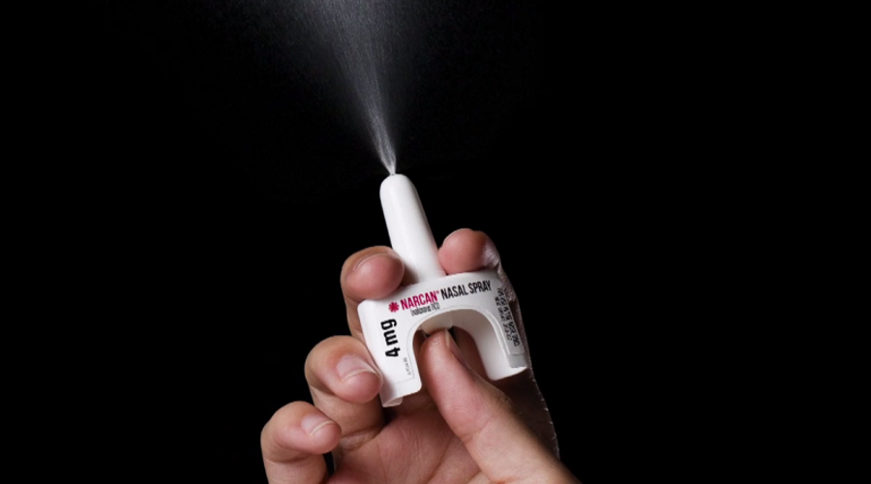
FDA - Narcan Over the Counter
FDA ruling on 3/29/23 allows for Narcan (nasal spray) to be sold over the counter
Manufacturers are working on production and packaging
Other formulations are available by prescription only

Slide 26
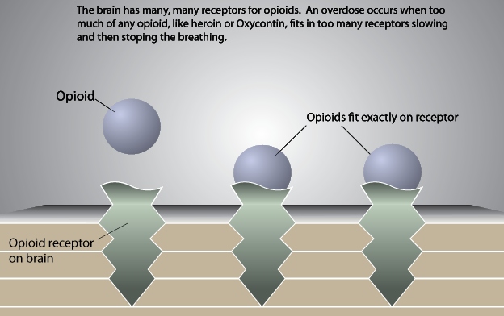
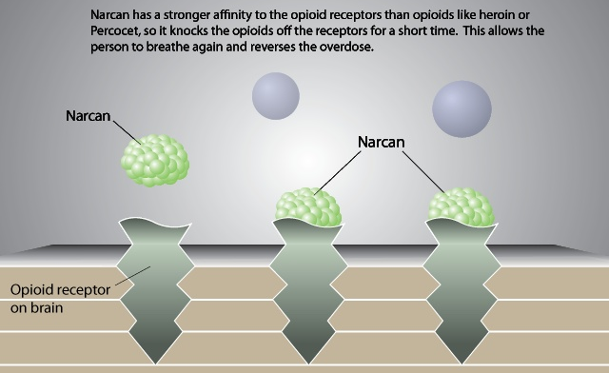
Naloxone
Non-addictive medication reverses opiate overdose
Cannot be abused nor cause overdose
Onset: 1-3 minutes
Duration: 30-90 minutes
Individuals released from jail, are 40% more likely to overdose within the first 2 weeks (than the general pop.)
Notes:
When naloxone is administered, the opioid is knocked off the receptor site and replaced by naloxone and the breathing is restored.
How we trained LEOs on Harm reduction.

Slide 27
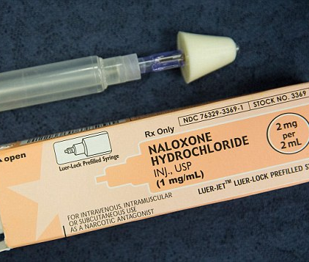
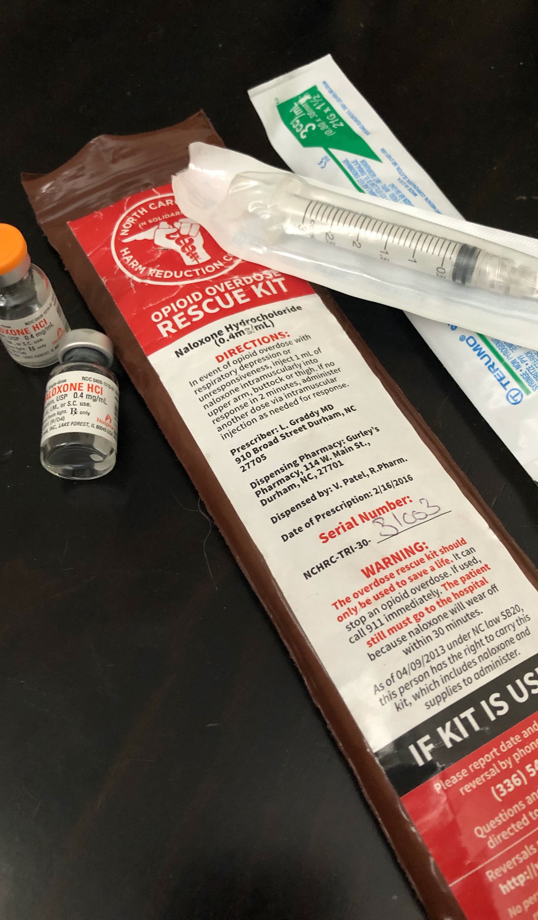
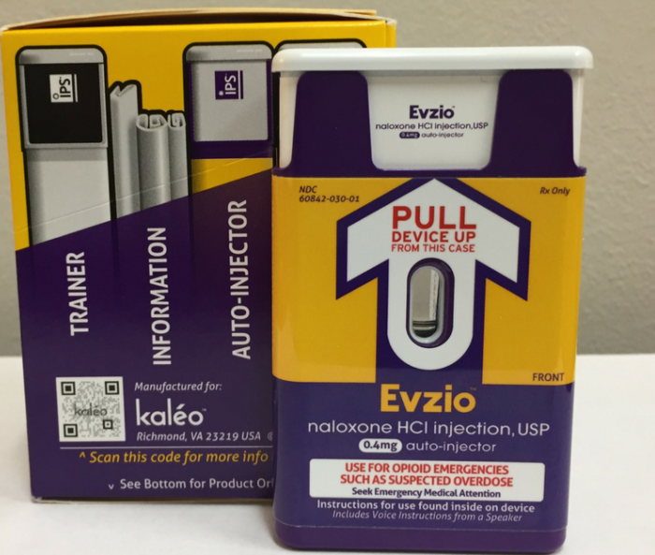
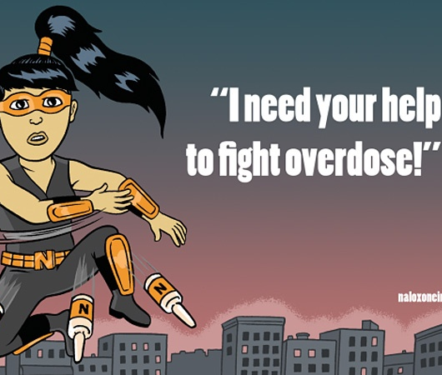

Slide 28
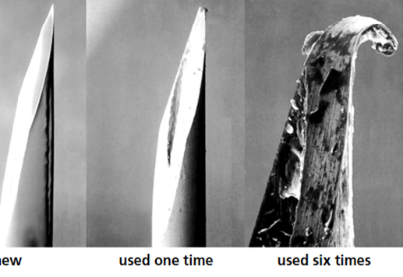
Syringe Exchange Programs

Slide 29
Other SSP Benefits
Significant reductions in HIV and hepatitis C transmission among participants and decrease in taxpayer burden to treat these diseases.
Fewer syringes discarded in streets (SSPs collect and incinerate used syringes).
SSPs are required to provide information pertaining to treatment services.
Research shows participants are five times more likely to seek treatment if they join an SSP. This can result in less crime and fewer calls for service for law enforcement.
”I am glad you are here”
Notes:
66% decrease in LEO First responder sticks (ER)
Idaho programs have a found syringe hotline so they can be picked up safely off the streets

Slide 30
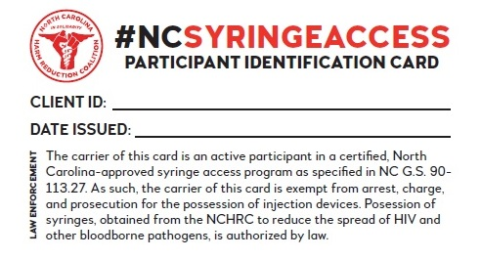
SSP Written Verification
Notes:
IDAHO does not have a card like this, could be an opportunity to help down the road

Slide 31
Law Enforcement Assisted Diversion (LEAD)
LEAD is a pre-arrest diversion program that utilizes officer discretion to divert low level drug offenders and sex workers from the traditional criminal justice system and link them into treatment. This linkage to services operates within a harm reduction framework to include intensive case management and peer support services.
58% Less likely to have a negative contact with law enforcement.
Lancaster County
Notes:
LEAD is a pre-arrest diversion program that utilizes officer discretion to divert low-level drug offenders and sex workers from the traditional criminal justice system. The program provides a harm reduction approach to community-based issues of substance use, mental illness, criminal justice system involvement, and social conditions. As more and more agencies are realizing the use of the traditional criminal justice is not appropriate or effective in addressing behavioral health issues, we are seeing the development of pre-arrest diversion programs.
Diverted individuals receive a ‘warm hand off” into wrap around services such as drug treatment, emergency housing, mental health treatment, peer support, and vocational training.
Benefits include redirecting officers back to the street to handle more pressing law enforcement priorities, reducing cost savings to social service and medical systems, and reducing drug related injuries to include overdose deaths, spread of communicable diseases such as HIV & Hep C, abscesses, etc.
What’s great about LEAD is the collaboration of existing stakeholders willing to come to the table to do something different. This program brings together treatment providers, law enforcement, the district attorney’s office, the LME/MCO, and harm reduction/peer support partners. LEAD does not require building an entirely new program; it is about bringing existing stakeholders together who have a common goal of reducing crime and connecting people with substance use disorders to treatment and supportive services.
Operating within a harm reduction framework, LEAD recognizes no one size fits all; everyone is on their own journey; we need to meet people where they are. There are no compliance guidelines or sanctions for participants. We believe in attempting re-engagement in services, not punishment. The LEAD program also recognizes that not everyone is treatment ready at the time of interaction with law enforcement. This is a new conversation between officers and people with a substance use disorder. But for those that are ready, the program is structured in a way that provides the referring officer a process in which to conduct a warm hand-off to a case manager.

Slide 32
Partnerships & Reducing Criminal Justice Involvement
Key Stakeholders
Public Safety
District Attorney’s Office
Case Management
LME/MCO
Harm Reduction Agency/Peer Support
Great time to problem solve
Removes silos between entities
Notes:
A key goal of this pre-arrest diversion program is to reduce criminal justice involvement. This is another time within the program in which you see the impact of bringing stakeholders together. Within each program there is a case staffing which occurs 1 to 2 times per month, based on the size of the program, in which the progress or challenges for each participant is reviewed. When participant barriers are identified, a plan of action is created to help support the individual.

Slide 33
Promising Practices
There is No Perfect Program
“It Matters to the Starfish”

Slide 34
Post Overdose Response
Process of connecting people at risk for future opioid overdose to a range of harm reduction and treatment related services. Peer Support is key.
Typically within 24-72 hours
Recognize the challenges
Sharing information to connect people
Identifying skill sets
Compassion Fatigue is real!
Notes:
A program that has shown success and can be carried out with or without law enforcement.
As of this update, Idaho does not have this program in place
Study show 6% of OD deaths happen within 24 hours of an overdose response.

Slide 35
EMS Naloxone Take Home Programs
Naloxone is left with individuals who refuse transport to the emergency department or with a family member or friend at the home
Several locations recently started a naloxone leave behind program with EMS agencies.
Notes:
Idaho Falls is providing technical assistance to organizations across the state who are interested in starting a program.

Slide 36
Things to Consider
Stigma and judgment is not productive
Reducing or eliminating drug use is a journey
You might be the catalyst for change (take active role in helping to reduce future CFS)
Lean on local partners who specialize in helping people who use substances.
Community Access to Naloxone: local public health department, pharmacies, SSPs, www.naloxonesaves.org
Are there syringe services locally?
Who are the local peer support specialists?
Notes:
Some local partners:
- Idaho Department of Health and Welfare (Division of Public Health and Division of Behavioral Health), local health departments, North Idaho Aids Coalition, Idaho Harm Reduction Project

Slide 37
QUESTIONS ?
Donnie Varnell, Investigator
Dare County Sheriff’s Office
NC State Bureau of Investigation
NCHRC.org
Donnie.varnell@darenc.gov
336-338-1507

